Slide 1
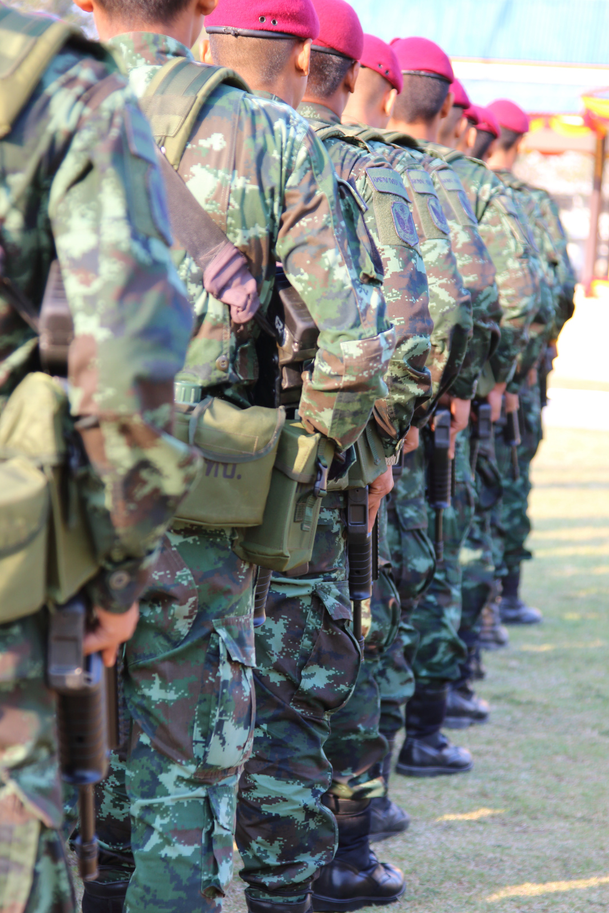
How Attorneys Can Assist Veterans
Presented by Katie Binkley, Esq. and
Caitlin Emmons, Esq.
Lead Staff Attorneys, Veterans Legal Institute

Slide 2

Veterans Legal Institute
We are a non-profit law firm serving low-income, homeless and elderly veterans. We have a team of attorneys in house, and can expand our reach through the help of our volunteer attorneys.

Slide 3

Increased Need in Veteran Community
Impact of deployments on family dynamics
Needing a discharge upgrade to access benefits
Financial problems resulting from disability
Starting a business or non-profit after discharge

Slide 4

  Expand skills in new practice areas
    ex: Discharge Upgrades require no litigation experience but allow attorneys to hone writing skills and advocate in a meaningful way.
  Make an impact by doing something routine
    ex: Helping a veteran submit a timely response in their case.
Benefit to Attorney

Slide 5

Benefit to Veteran
Legal relief with your help
Advice and strategy that the self help center cannot provide
Confidence to proceed in pro per
Value in feeling heard

Slide 6
The Power of a Consultation
Members of vulnerable communities know too well the feeling of a door closing on them. Consulting with a veteran about their lawsuit provides not just legal assistance, but a sense of relief--lawsuits can be emotionally exhausting, and a consultation can ease this burden.
1

Slide 7
VETERAN - SPECIFIC PRACTICE AREAS
Discharge Upgrades and Veteran Benefits

Slide 8
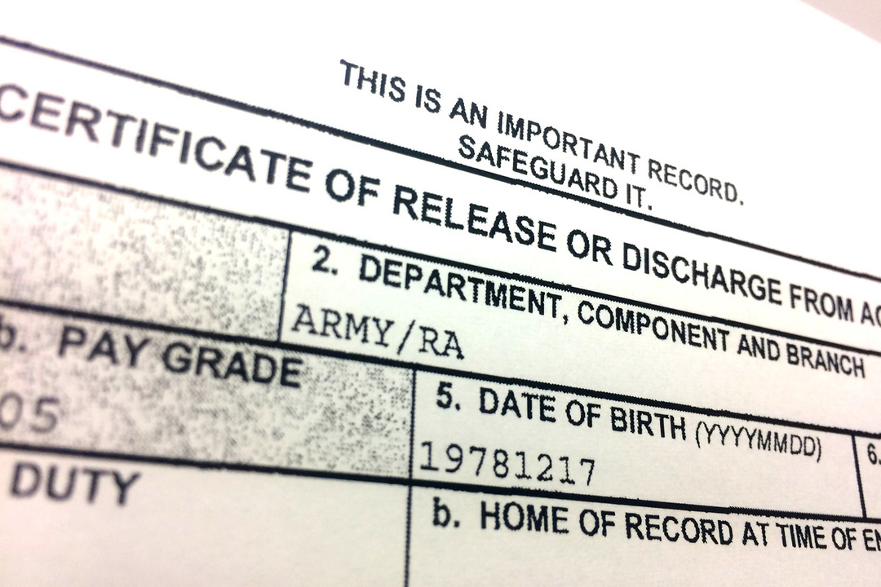
Discharge Upgrades
Overall: 15% success rate.
Veterans Legal Institute : 85% success rate.
No litigation experience required.
Success means connecting a veteran with health care, education benefits, disability compensation, etc.

Slide 9

Discharge Upgrade Process
Discharge Review Board:
The DRB can make changes to the character of discharge, separation codes, and re-enlistment codes. DRBs have a 15 year SOL.
Board for Correction of Military/Naval Records:
This board has broad authority to make any changes to a servicemember's records as required to correct errors or injustice.
Discharge Appeal Review Board:
The DARB is limited in what it can review. Only cases where the veteran was discharged post Dec. 2019 and only an administrative records review, no new evidence.
The Boards are administrative. In addition to a DD form the application consists of an appellate style brief and evidence.

Slide 10



Veterans Benefits
Most common: Disability compensation
Monthly compensation
Must establish service connection
Show causal connection
Other benefits:
  Wartime Pension
  Education Benefits
  Home Loans
  Healthcare

Slide 11
VA Accreditation
Prepare, present and prosecute claims before the VA.
Easily submit VA Form 21a to apply.
Complete three hours of CLE in the first 12 months.
Visit https://www.va.gov/ogc/accreditation.asp for more information.

Slide 12

Recognizing Trauma
Post Traumatic Stress Disorder (PTSD): agitation, irritability, hyper-vigilance, social isolation, mistrust, severe anxiety, insomnia, nightmares
Traumatic Brain Injury (TBI): mental confusion, difficulty concentrating, uncontrollable laughing or crying, inability to remember details. May cause physical health issues
Military Sexual Trauma (MST): sexual assault or harassment during service; may be unreported, or not prosecuted. It is estimated that 50% of women in service experience MST.
These traumas can impact service and can influence the attorney client relationship.

Slide 13
ASSIST IN GENERAL PRACTICE AREAS

Slide 14

General Practice Areas
Family Law
  Dissolution of Marriage
  Custody Modification
  Guardianship/Adoption
  Child/Spousal Support

Slide 15


FL Pro Bono Types
Focus on Family Law
  Limited Scope appearance
  Judicial Council forms
    Self Help Center packets
  Draft a declaration or brief
  Negotiations with opposing counsel
  Explain a settlement offer
  Write a stipulation

Slide 16

General Practice Areas
Estate Planning
  Wills and Trusts
  Burial Requests
  Durable Power of Attorney
  Health Care Directive

Slide 17
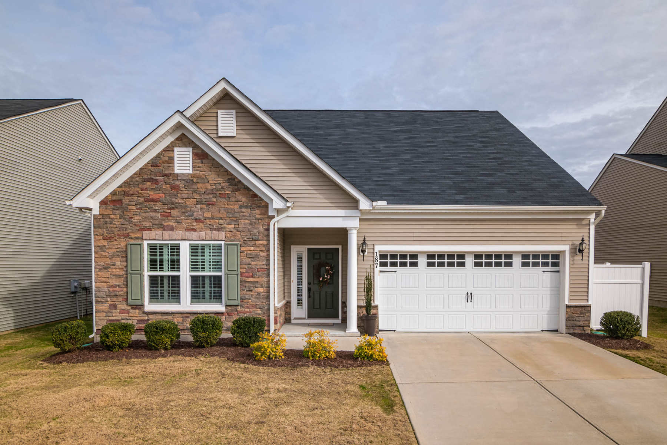
General Practice Areas
Housing
  Unlawful detainers
  Property tax exemption for disabled veterans.
  Small claims assistance for return of security deposit.

Slide 18

General Practice Areas
  Bankruptcy
  Expungements
  Business Formation

Slide 19
Varying Capacities to Give Back
Take a case pro bono
Prep Judicial Council forms for a pro per.
Help VLI with their fundraising.
Volunteer at a legal aid clinic

Slide 20
Volunteer with Veterans Legal Institute!
Monthly legal clinics in general and specialized practice areas (like family law), as well as a monthly caeslist with veterans in need of volunteer attorneys.
Visit www.vetslegal.org or email kbinkley@vetslegal.com or cemmons@vetslegal.com for more information.
1

